Slide 1




Mapping Real Estate in Egypt
DEPI GRAD PROJECT
TEAM 3: DATA WIZARDS

Slide 2





Furqan Sarhan
Sara Ashraf
Our Team
Member
Member
Ahmed Wael
Team Leader
Nourhan Safwat
Marwa Ebrahim
Member
Member

Slide 3
Project Overview
Data Sources
Problem Statement
Table of Content
Objectives
Project Workflow
Data Cleaning
Data Modeling
Reporting

Slide 4

Project Overview
Mapping Real Estate in Egypt is a data-driven analysis project built to compare investment opportunities in the New Administrative Capital vs New Cairo.
It provides investors and developers with a clear dashboard to visualize price trends, infrastructure quality, and future growth potential, while considering economic factors like inflation and currency devaluation.

Slide 5

Problem Statement
Investors face "Information Overload" and conflicting marketing claims. There is a lack of an objective, data-backed tool to measure the real Return on Investment while considering economic factors like inflation and currency devaluation.

Slide 6
Data Sources
Data | Source | Format
Dubbizle | https://www.dubizzle.com.eg/en/new-cairo/ https://www.dubizzle.com.eg/en/new-capital-city/ | CSV/XLSX
PropertyFinder | https://www.propertyfinder.eg/en/search?l=2255&c=1&fu=0&ob=mr https://www.propertyfinder.eg/en/search?l=40470&c=1&fu=0&ob=mr | XLSX
Kaggle | https://www.kaggle.com/datasets/hassankhaled21/egyptian-real-estate-listings https://www.kaggle.com/datasets/mohamedebrahim88/greater-cairo-real-estate-prices-dataset https://www.kaggle.com/datasets/iyadelwy/egypt-housing-prices https://www.kaggle.com/datasets/mohammedaltet/egypt-houses-price | CSV

Slide 7
Data Sources
Data | Source | Format
CAPMAS | https://www.capmas.gov.eg/data/mainSubject/1/subSubject/18 | PDF
World Bank Group | https://www.worldbank.org/ext/en/home | PDF
Central Bank of Egypt | https://www.cbe.org.eg/en/ | PDF

Slide 8
Questions to answer
Market Valuation & Pricing: What is the specific price disparity between New Cairo and the New Administrative Capital, and how does the price per square meter reflect the investment value in each?
Supply & Inventory Composition: Which property types dominate the current listings, and how is the inventory distributed between the two cities in terms of volume and unit variety?
Delivery & Finishing Readiness: What is the timeline for property availability (Ready to Move vs. Future Delivery), and what level of finishing (e.g., Super Lux vs. Core & Shell) characterizes the majority of the current supply?

Slide 9
Project Workflow
steps we’re following during our project
Sourcing
Cleaning
Modeling
Collecting data from their sources
Fixing problems with the data coming from their source
Making relations between different tables using STAR schema
DAX
Sample Visual
Reports & Dashboards
Performing DAX calculations using formulas
Explaining what some visuals are used for
Delivering 5 Reports +
1 Big Summary Dashboard

Slide 10
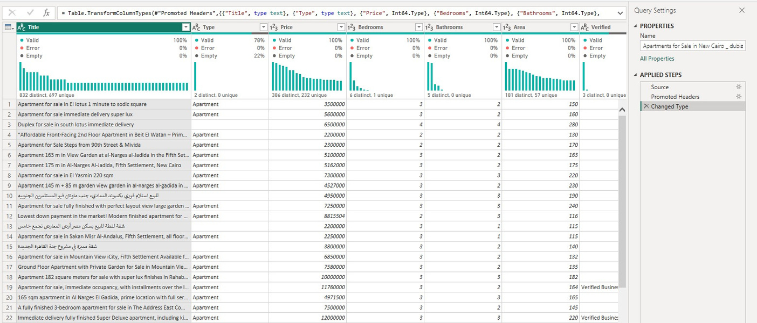
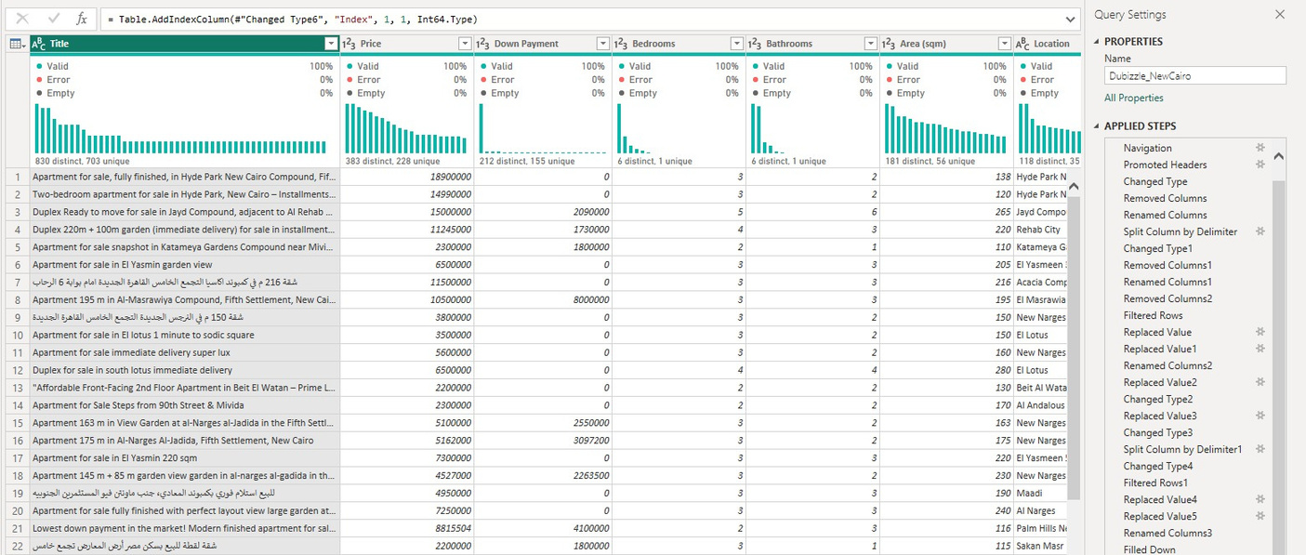
Data Cleaning
Refining the dataset and using "Data Imputation" techniques to handle inconsistent or missing information.
BEFORE
AFTER

Slide 11
Data Cleaning
Refining the dataset and using "Data Imputation" techniques to handle inconsistent or missing information.
BEFORE
AFTER

Slide 12
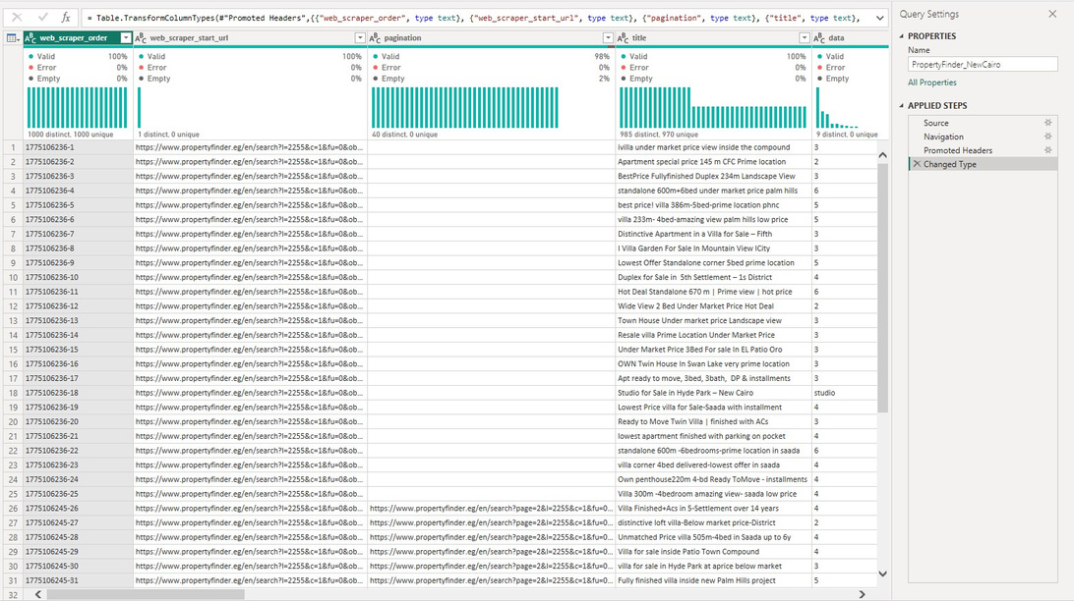
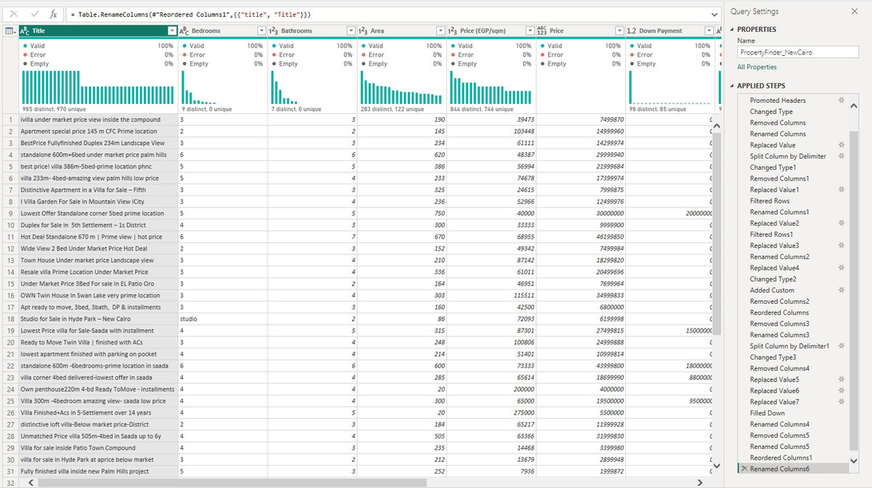
Data Cleaning
Refining the dataset and using "Data Imputation" techniques to handle inconsistent or missing information.
BEFORE
AFTER

Slide 13
Data Cleaning
Refining the dataset and using "Data Imputation" techniques to handle inconsistent or missing information.
BEFORE
AFTER

Slide 14
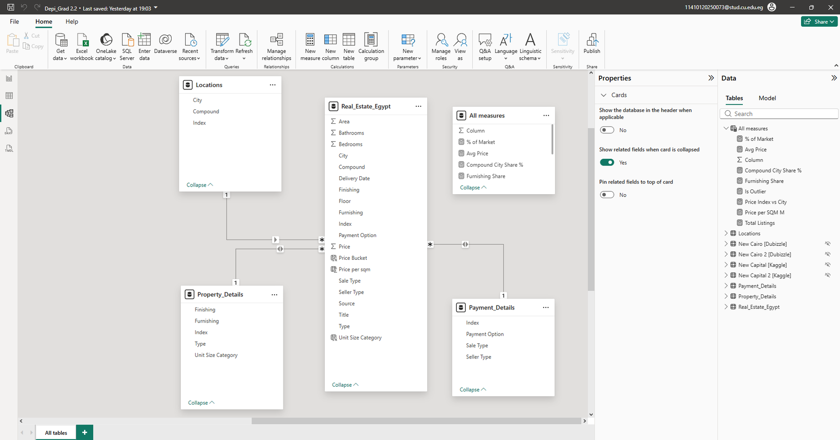
Data Modeling

Slide 15
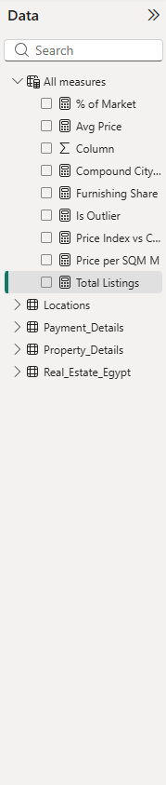
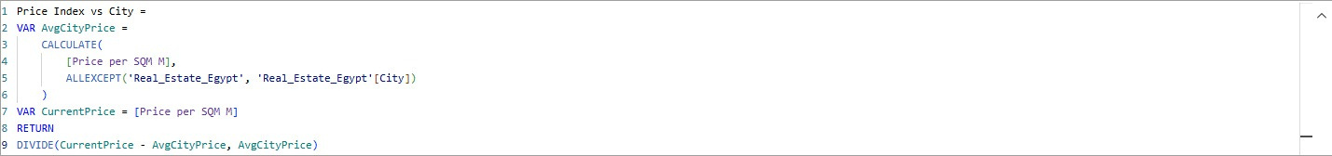
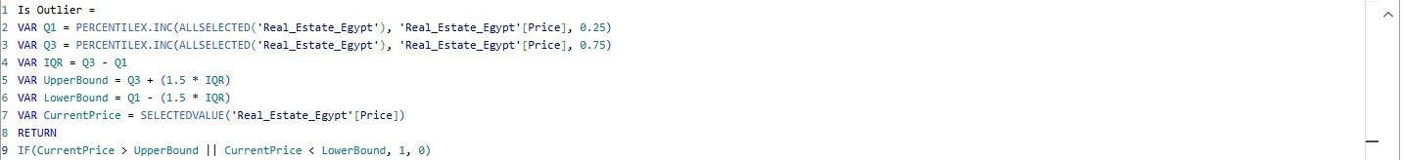
DAX
A formula language in Power BI used to create custom calculations, measures, and calculated columns for advanced data analysis, modeling, and dynamic reporting.

Slide 16
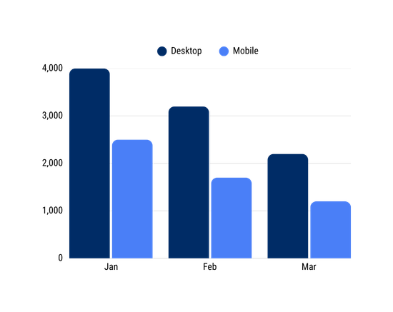
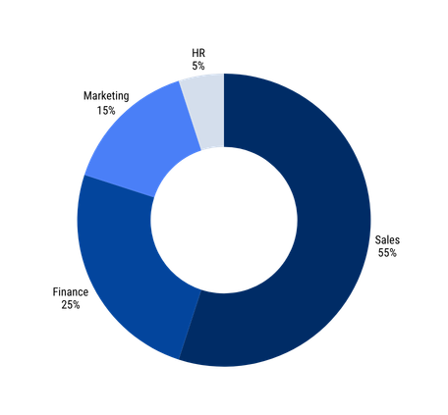
Sample Visual
These charts are used to perform side-by-side comparisons between multiple data series across distinct categories. They are designed to highlight differences and variances between groups, making it easy to identify trends and compare individual values directly within a single view.
Clustered Bar Chart
These visuals are ideal for representing "part-to-whole" relationships and illustrating categorical proportions. By focusing on the arc length, they allow the viewer to quickly understand the distribution of a total amount among various segments and evaluate the relative weight of each category.
Donut Chart

Slide 17
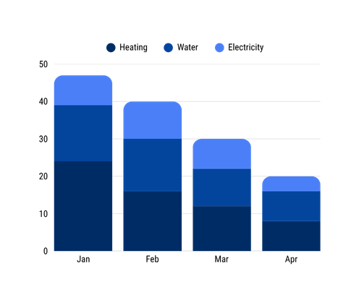
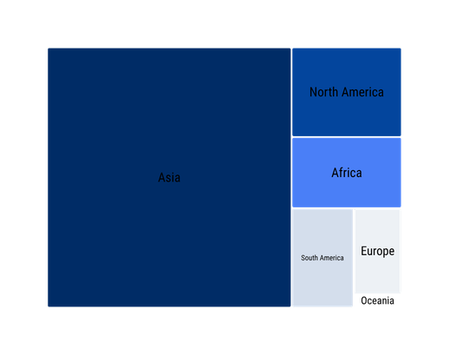
Sample Visual
These charts are used to visualize the internal composition of a total value by breaking it down into sub-categories. They provide a clear view of how different components contribute to the overall sum, while still allowing for a primary comparison of total volumes across different data points.
Stacked Column Charts
Treemaps are used to display large sets of hierarchical data through nested rectangles of varying sizes. This visual is effective for ranking categories and identifying dominant patterns within complex datasets, where the area of each rectangle is proportional to the value it represents.
Treemaps

Slide 18

Reports

Slide 19
Recommendations & Insights
The Egyptian real estate market is large, dynamic, and highly active, yet it follows clear and consistent patterns rather than randomness.
Market demand is primarily driven by families, as reflected in the dominance of medium-to-large units and 3-bedroom properties.
Pricing is not fixed; it is shaped by the interaction of multiple factors, including location, property specifications, and market supply.
The continuous increase in listings over time reflects a rapidly expanding and evolving real estate market.
The dominance of unfurnished units highlights buyers’ preference for flexibility and customization.
Ultimately, successful real estate decisions are not based on a single metric, but on a comprehensive understanding of the entire market landscape.

Slide 20
Thank You

